Slide 1
Deploy
Microsoft Power Platform
Govern
&
Grow
1. Secure
2. Monitor
3. Alert and Action
4. Deploy
5. Nurture
6. Infrastructure
7. Support

Slide 2
Deploy: What we plan to cover
1. Secure
2. Monitor
3. Alert and Action
4. Deploy
Product discovery: understand the origin of apps & flows | Review out-of-box analytics | Leverage management connectors & PowerShell to automate your policies | Understand managed vs unmanaged solutions
Know your environments | Configure audit logs | Welcome new makers and foster best practices | Learn the Application Lifecycle Management (ALM) toolset and best practices
Learn the 5 layers of security + the one that maters most | Leverage management connectors & PowerShell as powerful reporting tools | Identify and empower champions
Setup data loss prevention policies

Slide 3
ALM Overview + Toolset + Roadmap

Slide 4

The GAP is real
Why can’t I have my apps in source control
Why do I need to update production environment manually
Why do I need solution packager
Why does Microsoft not offer a 1st party Azure DevOps extension for PowerApps
What’s the ALM story for Canvas Apps and Flows?

Slide 5
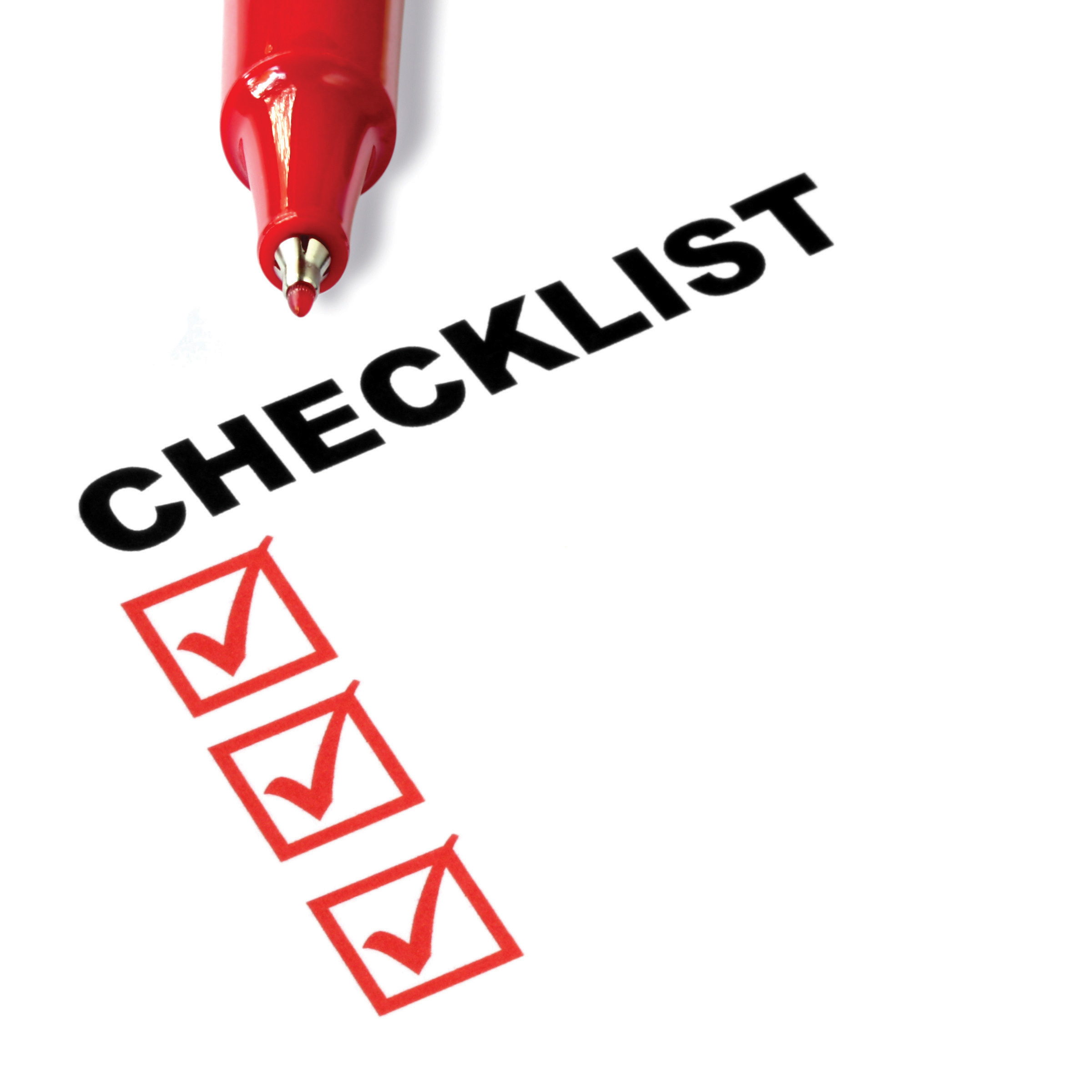
What to expect from this session
Fundamentals: Solutions and ALM Health
Azure DevOps: Source Control made simple
Pro-dev: PowerApps CLI & Azure DevOps

Slide 6



Fundamentals: Solutions
Solution
Data Model
Entities
Attributes
Forms
Views
Charts
Relationships
Global Option Sets
User Interface
Model Apps
Canvas Apps
Web Resources
PCF Controls
Dashboards
Sitemap
Dialogs
Solutions are used to package and maintain components that make up one or more PowerApps
Solutions are created and authored by a Publisher
Process/Code
Assemblies
Custom Activities
Plug-ins
Workflow Definitions
Flows
Workflow
Business Process
Rules
Other
Reports
Templates
Security Roles
FLS Profiles
System Settings (transport only)
Virtual Entities
App Modules

Slide 7
Fundamentals Managed vs. Unmanaged
Unmanaged Solutions are to be used in development environments while you are making configuration changes to your application. Solutions are exported as unmanaged and checked into your source control system. Unmanaged solutions should be considered your source.
Managed solutions are used to deploy to any environment outside of development. This includes test, UAT, SIT, and production environments. Managed solutions should be generated by a build server and considered as a build artifact.

Slide 8
Fundamentals: Solution Layering
Application Behaviour
Layering occurs on import of solutions
Layers describe the dependency chain of component from the root solution introducing it, through each solution that extends or changes the component’s behavior
Layers are created through extension of an existing component (taking a dependency on it) or through creation of a new component or version of a solution.
What the user sees
Unmanaged “layer”
Unmanaged Customizations
Unmanaged Solution C
Unmanaged Solution D
Managed Layers
1 per managed solution
Managed Solutions
Managed Solution B
Managed Solution A
System Layer* CDS Managed Layer
System Solution*
Base CDS entities

Slide 9
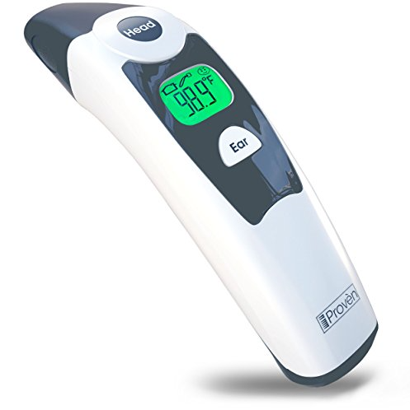
Fundamentals: ALM Health Check
Source Control definitive source of truth
Are you shipping as managed?
Are your Dev environments disposable?
100% automated ALM?
Developer isolation?
Service production while working on v-next?
Using SolutionPackager?

Slide 10
Fundamentals: Solutions Health Check
Solution segmentation?
Supported techniques only?
Testing in UC and using AppModules?
Single publisher?
Solution Checker?
Separate environments for each solution?
Only have your managed dependencies installed?
Using Upgrade pattern?

Slide 11
What’s new for Solutions
Solution Experiences
Guided help (rolling out)
Solution Framework
Solution History
Solution Layering
Undo unmanaged customizations
Performance Improvements
Solution Import Wizard changes
AI Builder Models
Custom connectors
Improvements for Canvas and Flow
Environment variables (rolling out)
Classic capabilities available in modern

Slide 12
What’s next for Solutions
Solution Experiences
Modern Solution Import, History, Layering, and Undo Active Customizations
Solution Framework
Goal: zero downtime solution imports
Merge format for unmanaged export
Custom Solution Components (1st party)
Dependency improvements
Data flows and UI flows
Re-direct from legacy solution explorer
UX improvements
Connections

Slide 13
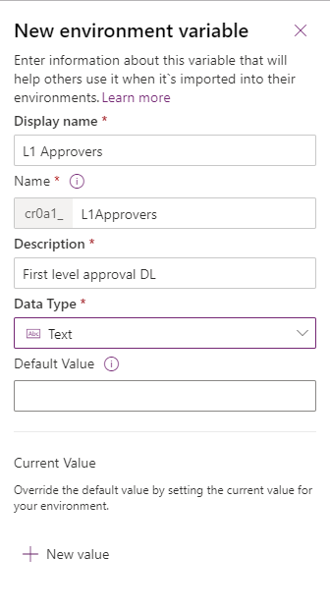
Environment variables
Migrate application configuration data in solutions
Use as configurable input parameters in model-driven apps, canvas apps, and flow
Update values without modifying these components directly
Optionally update values in build pipeline

Slide 14

Demo
Environment variables in Flow

Slide 15
DevOps

Slide 16
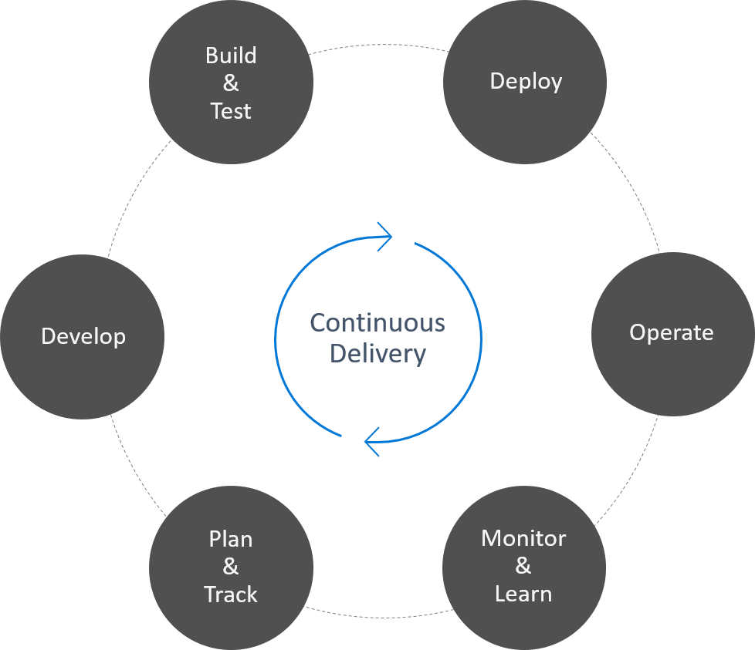
What is DevOps?
"DevOps is the union of people, process, and products to enable continuous delivery of value to our end users."
— Donovan Brown

Slide 17
DevOps – what’s the value?
The greatest value add from implementing DevOps is gained through the automation of manual processes allowing for the continuous delivery of value to customers.
Automate build and deploy
Increased speed to market
Faster mean time to resolution

Slide 18



ALM Powered by Azure DevOps
Initiate
Build
Release
Getting started, faster
Build and Walk away
Automated, Predictive, Repeatable
Provision
Environment
Deploy
Dependencies
Pack Source
Code from
Repo
Import
Solution
Run Unit Test
Run Solution
Checker
Export
Solution
Unpack to
Repo
Run Unit Test
Pack Solution
Run Solution
Checker
Run
Integration
Test
Import as
unmanaged
Increment
Version
Export
Managed
Initial Build Pipeline instantiates pristine Development Environment daily
Build Pipeline Automates manual steps.
No more upload to Solution checker and
manually export solution, unpack and
push to repo
Automated Release Pipeline removes manual steps. Weekly, daily or hourly releases becomes the new standard
Powered by Azure DevOps

Slide 19
From Environment Centric to Source Control
Install PowerApps Build Tools
Create a Build pipeline to Export from Dev
Create a Build Pipeline to generate build artifact
Create a Release Pipeline to Deploy to production

Slide 20
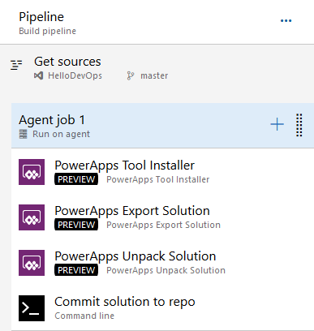
Build Pipeline: Export Solution from Dev
Tools Installer
Export Solution
Unpack Solution
Commit Solution to repo

Slide 21
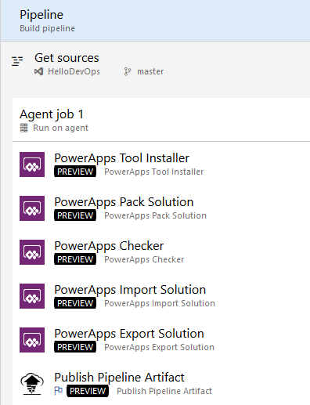
Build Pipeline: Build Managed Solution
Tools Installer
Pack Solution
PowerApps Checker
Import Unmanaged Solution
Export Managed Solution
Publish Pipeline Artifact

Slide 22
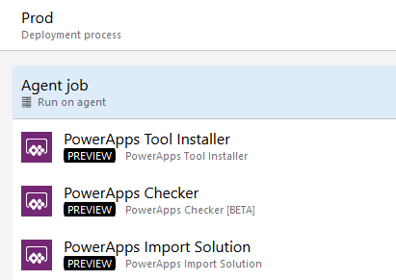
Release Pipeline: Deploy to Production
Install Tools
Checker Solution
Import Solution

Slide 23
Demo
From Environment to Source Control

Slide 24

But what about my code?
How can my code participate in the same Application Lifecycle

Slide 25
CLI Option 1
Build the plugin
Register plugin
Add to solution
Use existing pipelines for CI/CD

Slide 26
Demo
Use CLI to build your plugin and add it to your solution
pac plugin init
Register the plugin using plugin registration tool
Add the plugin to your solution
Use regular build pipeline to move solution to source control and deploy to downstream environments

Slide 27
CLI Option 2
Build the Plugin
Register the Plugin
(Clone) Solution to Source
Add to Solution
Add Reference to CDS Proj
Modify Build Pipeline to use the new Build Model

Slide 28
Demo
Use Clone to pull solution to source and add your plugin
pac plugin init
Register the plugin using plugin registration tool
Add the plugin to your solution
pac auth create --url <ENVIRONMENT URL>
pac solution clone –name <SOLUTION>
pac solution add-reference –path <path to plugin>
Msbuild /restore
Update Build pipeline

Slide 29
What’s coming for PowerApps Build Tools
Environments as Azure DevOps variable
Support for both Dynamics 365 CE & CDS Environments
Service Principals Auth
Async Solution Import
AppSource Deployment Task

Slide 30
Documentation refresh and deprecation of old assets
DevOps: Why should you care
What is Azure DevOps: Getting Started
Zero to Full Source control: From Environment centric to Source centric
PowerApps DevOps Part I: Build your first Pipeline
PowerApps DevOps Part II: Automate your releases
PowerApps DevOps Part III: Integrate Code in your build and release Pipes
Packaging your app: Working with Solutions
Manage: Work with Environments and manage your apps

Slide 31
Resources
PowerApps Build Tools
https://aka.ms/ppalmlab
PowerApps Build Tools multi-stage YAML Pipelines
PowerApps Documentation -> I’m a developer -> Package and distribute apps/extension
PowerApps Blog – ALM
Community:
Marc’s YouTube channel
Wael’s blog

Slide 32
Next Steps

Slide 33
Session Opportunities at Ignite 2019
ALM Workshop (WRK1007)
Where: OCCC W221 E
When: Tuesday 4:00 – 5:15pm
What: Hands on workshop to learn how to use DevOps with the Power Platform
PowerApps Quality Tools (BRK2222)
Where: Hyatt Florida Ballroom
When: Thursday 9:15 – 10:00 am
What: Learn how to build, test, and troubleshoot high-quality and high-performance PowerApps apps by using built-in tools like App Diagnostics, PowerApps Test Framework, Solution Checker, and App Checker.

Slide 36
Admin in a Day - ALM
THR2021
Evan Chaki
Principal Group Program Manager – ALM
Per Mikkelsen
Principal Program Manager

Slide 37
Agenda
Roadmap
Next Steps

Slide 38
Deployment scenarios
Supporting Power Users
Centrally Managed Apps
Helping power users share the apps and flows they built
Typically single environment
Export and import of individual components for backup/restore
Could add-on or extend some centrally managed assets
More formal process for rolling out updates
Often involves multiple environments e.g. dev/test/prod
Solutions are used to allow export/import of a set of assets
Could include installation and configuration of App Source solutions

Slide 39
High level deployment tasks
Coordinate with makers
Export from development
Import to test
Setup Connections
Associate Security Roles
Share to make available
Repeat for production
Notes:
Process shows for test and is repeated for production using the same solution that was exported from development

Slide 40
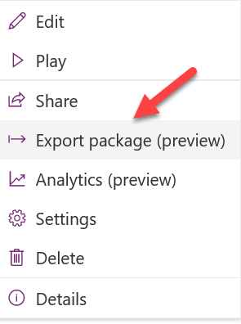
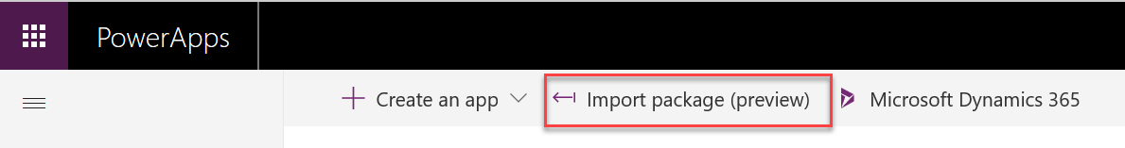
Working with individual resources
Canvas apps and flows can individually be exported and imported to move between environments
Environment A
Environment B
Notes:
Moving individual resources is the preferred approach only when CDS is not present in the environments to allow use of solutions.
Exporting an individual resource can also be used for application backup purposes

Slide 41
Solutions Overview
Solutions are a container to track the changes you make including apps, flows and CDS components
Solutions are how you transport and install changes to target environments
Microsoft Dynamics 365 apps are installed using solutions
3rd party apps provided by Independent Software Vendors (ISVs) also use solutions
Development
Test
Production
Notes:
Solutions are containers that track and manage customizations in a CDS environment
If you have multiple environments, each would have their own set of solutions. Solutions can include entity metadata, forms, views, business rules, processes definitions and other assets required to run the app; including components created by developers like scripts or compiled code.
when you have a Dynamics 365 application like Sales or Service those are installed using the same solution framework. 3rd party ISVs also ship their products using solutions

Slide 42
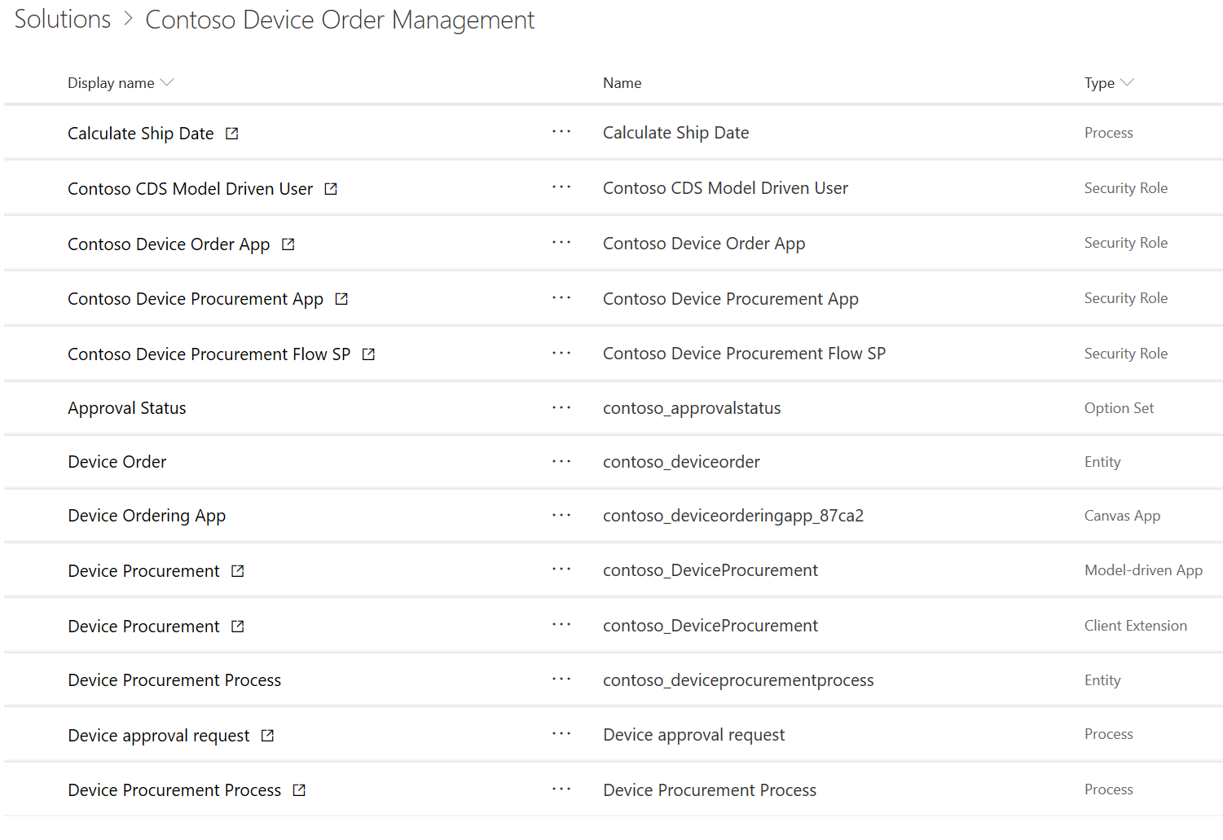
Contoso Device Ordering Solution Example
Solution – Device Ordering
Apps
Data (Entities)
Processes
Device Ordering
Device Order
Order Approval Flow
Device Procurement
Device Procurement Process
Security Roles
Device Ordering App role
Device Procurement App role
Device Procurement Flow role

Slide 43
Types of Solutions
Unmanaged
Managed
Used during development
Used to transport to other development environments
Used to distribute to non-development environments

Slide 44
Application Lifecycle with Solutions
Development Environment
Test Environment
Production Environment
Data Model
Forms
Device Ordering
Solution
Device Ordering Solution
Device Ordering Solution
Roles
…
Export as unmanaged
Export as managed
Import managed
Import managed
Notes:
It’s important to note that you should always have secured an unmanaged copy of the solution in addition to the managed copy. The unmanaged is needed if you have to re-create the development environment in the future.

Slide 45
Environment with Multiple Solutions
Innovation Challenges
Employee Referrals
Employee Kudos
Test Environment
Device Ordering
Contoso Shared Components
CDM/System Entities

Slide 46
Solution Tooling
PowerApps Build Tools
Configuration Migration
Solution Packager
Package Deployer
CDS Web API
Solution Checker
Notes:
https://github.com/WaelHamze/dyn365-ce-vsts-tasks

Slide 47
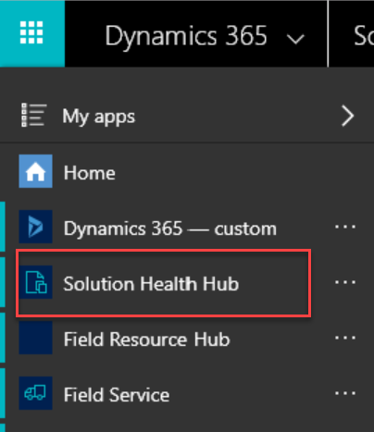
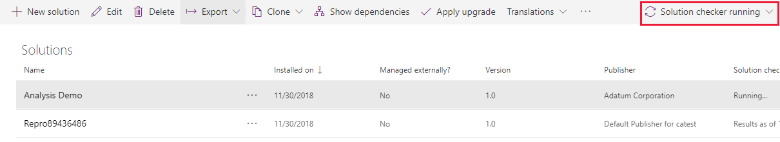
PowerApps Solution Checker/Health Hub
Solution Checker does static checks to identify performance, stability, and reliability issues with Solutions
Solution Health Hub runs rules to validate the configuration of an environment
Notes:
More details here https://docs.microsoft.com/en-us/powerapps/maker/common-data-service/use-powerapps-checker
Makers should use Solution Checker to ensure their solution is ready for prime time
Administrators can check status of Solution Checker to ensure promoting solutions to productions that don’t have issues
Solution Health Hub is a model-driven app that allows creating, viewing and running health rules in an environment
Administrators can use and define Health Hub rules to ensure the solution is configured properly in the target environment

Slide 48
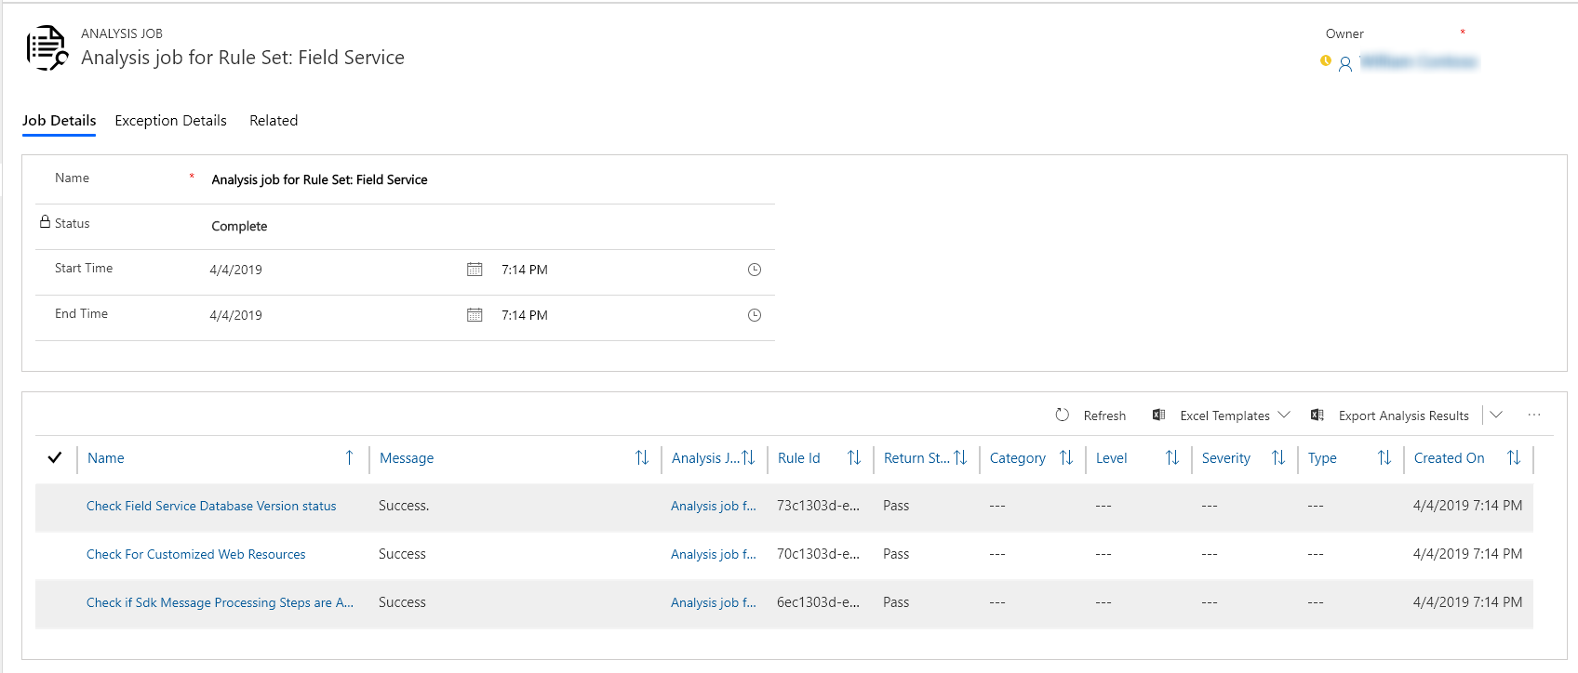
Solution Health Hub
Rules are used to validate configuration
Resolve problems by pre-defined corrective actions
Notes:
More on Health Hub here - https://docs.microsoft.com/en-us/dynamics365/customer-engagement/admin/solution-health-hub

Slide 49
Environment Variables
Allows values that differ between environments to be dynamically replaced instead of hard coded
Defined by makers as part of a Solution
Can be used by flows and via API for initial release
Solution can contain default values
After import to target environment, blank values must be established
Notes:
Environment variables are solution components
Upon import, portal will prompt that there are missing values and administrator can update
After initial update to change or see values admin goes to default solution and looks and/modifies the variable value

Slide 50
Example – Environment Variables
Development
Test
Production
Var – From Email
Var – From Email
Var – From Email
Value – dev@contoso.com
Value – test@contoso.com
Value – prod@contoso.com
Var – Auto Approve
Var – Auto Approve
Var – Auto Approve
Default – Yes
Default – Yes
Value – No
Decimal, JSON, Text, and Two Options are supported data types
Notes:
This diagram illustrates how environment variables can be used to tailor values for each environment
Note that you can provide a default value that is used if a current value is not specified in a particular environment

Slide 51
Assigning Security Roles
Manual association
Using Azure AD Groups
User added to environment
User optionally added to team
Security role assigned to user or team
Team created in CDS and associated with Azure AD Group
Security roles assigned to CDS Team
Users added to Azure AD Group automatically added to CDS Team
Notes:
Both Office Group and Security Groups are supported – correct type must be chosen when configuring the CDS team

Slide 52
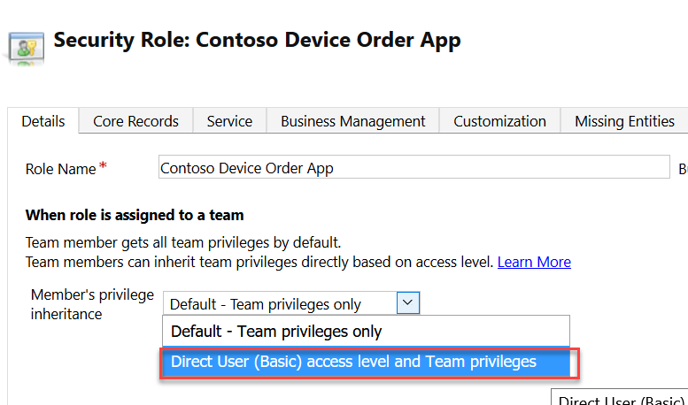
Direct User Team Privileges
Changing to Direct User treats privileges as if they were assigned directly to the user
Notes:
Security Roles used need to be configured to have Direct User privileges if users are to own records directly
Team privileges only: User is granted these privileges as member of the team. For team members who do not have user privileges of their own, they can only create records with the team as the owner and they have access to records owned by the Team when Basic access level for Create and Read were given.
Direct User privileges: User is granted these privileges directly when a security role is assigned to the user. User can create and has access to records created/owned by the user when Basic access level for Create and Read were given.

Slide 53
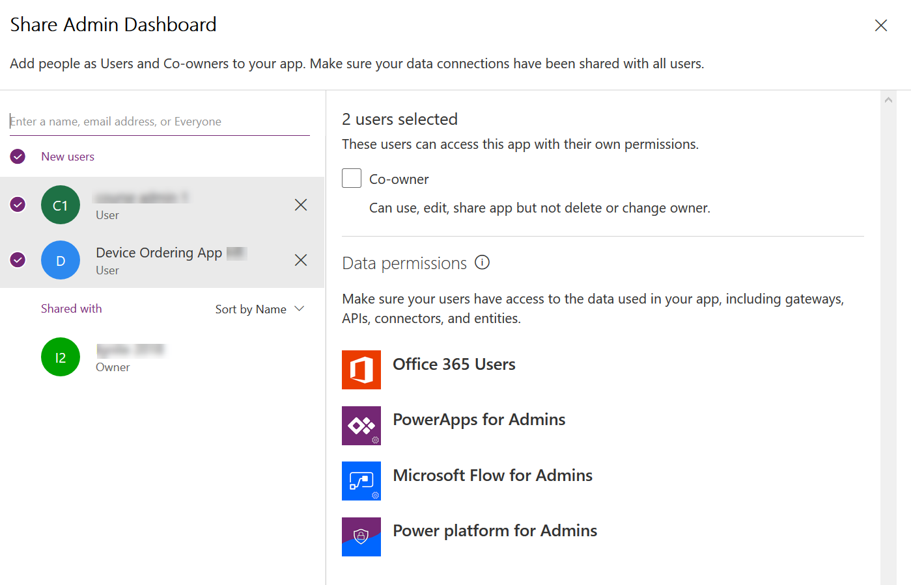
Sharing a canvas app
Notes:
Can share with a User directly or with a Azure AD Group
Must already have access to CDS Data via security role assignment to Azure AD Group or directly to the user

Slide 54
Flow Connector User Security Context
Instant Flows
Scheduled Flows
Automated Flows
Co-Owner or Run-Only
Allow using existing connection or require them to use their own
Can choose for each connection used
Settings are for all Run-only users, you can’t individually set
Co-Owner
Uses existing connection, any owner can change
Co-Owner
Uses existing connection, any owner can change
Notes:
When configuring instant flows if you choose to use existing account it generally shouldn’t be an admin account otherwise it could

Slide 55
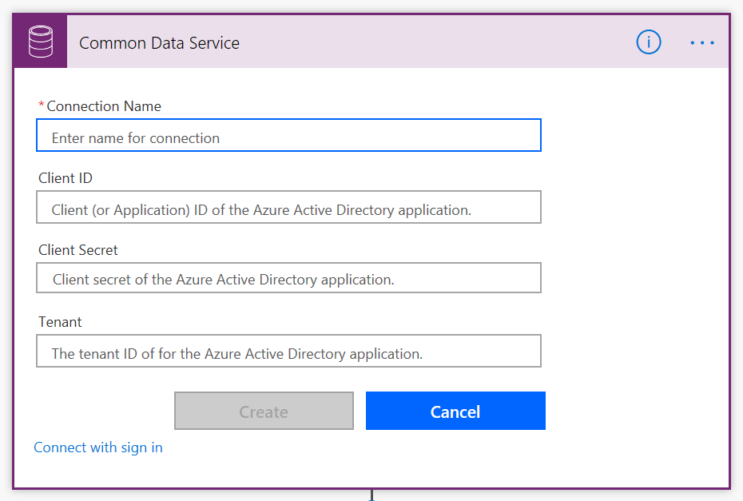
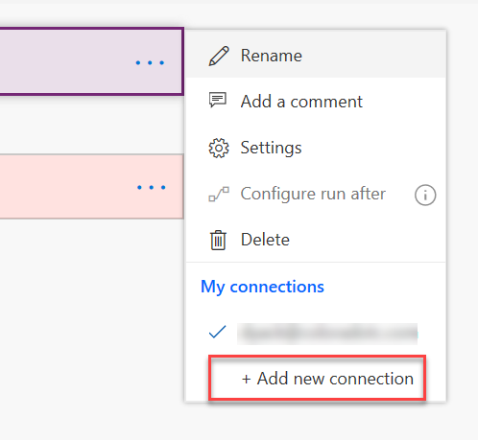
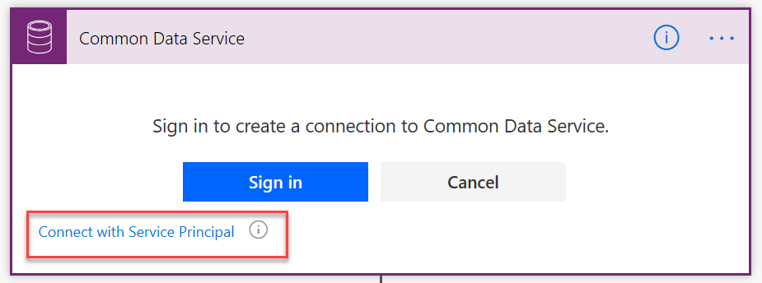
Using a service principal with CDS Connector
By default, sign-in uses interactive user that requires an appropriate license, and executes in the user's context
Using a service principal allows actions to be executed using a CDS App User context

Slide 56
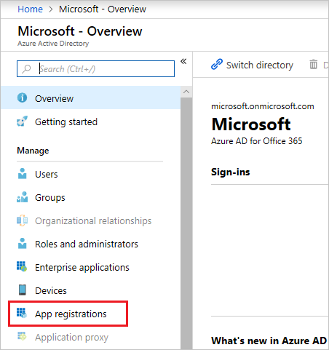
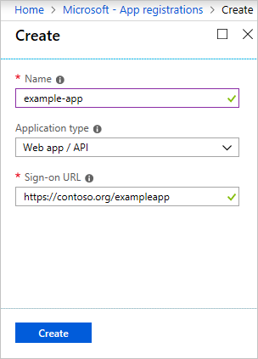
Preparing a service principal
portal.azure.com
Create a CDS Security Role
Create a CDS App User
Needs base permissions, currently Environment Maker or similar
Needs permissions to anything your flow will do
Minimal permissions are best
In the Classic web app
Settings - >Users
Set view to App User
Set form to App User
Use Azure AD App Info
Assign security role after creation

Slide 57
Module Review
Work with makers early to prepare for how apps and flows will be deployed
Using Solutions to deploy offers the best application lifecycle management experience
Notes:
Start Time xx:xx / Length: 2 minutes
Review the objectives for this module.
Ask participants to use the Text tool to write on the screen if they had any questions about the module.

Slide 58
Session Resources: Documentation
Solution Checker Documentation:
https://docs.microsoft.com/en-us/powerapps/maker/common-data-service/use-powerapps-checker
PowerApps Blog:
https://powerapps.microsoft.com/blog/
Working with Solutions in PowerApps
https://docs.microsoft.com/en-us/powerapps/maker/common-data-service/solutions-overview
Introduction to Solutions
https://docs.microsoft.com/en-us/dynamics365/customer-engagement/developer/introduction-solutions
Solution Lifecycle Management Whitepaper (Phil Hand)
https://www.microsoft.com/en-us/download/details.aspx?id=57777
Notes:
This slide is required. Do NOT delete. This slide is recommended as a final slide to recap additional resources.
Use this slide to share additional available content that attendees can leverage after the event. In this section you can call out whitepapers, websites, communities, etc. that might be useful for the learner.

Slide 59
Session Resources: Tools
CoreTools (including Solution Packager) of SDK:
https://www.nuget.org/packages/Microsoft.CrmSdk.CoreTools
Powershell modules of the SDK:
https://docs.microsoft.com/en-us/powershell/dynamics365/customer-engagement/overview?view=dynamics365ce-ps
Azure DevOps CI/CD tools by MVP Wael Hamze
https://marketplace.visualstudio.com/items?itemName=WaelHamze.xrm-ci-framework-build-tasks
Microsoft.Xrm.Data.Powershell modules
https://github.com/seanmcne/Microsoft.Xrm.Data.PowerShell
Notes:
This slide is required. Do NOT delete. This slide is recommended as a final slide to recap additional resources.
Use this slide to share additional available content that attendees can leverage after the event. In this section you can call out whitepapers, websites, communities, etc. that might be useful for the learner.

Slide 60
Videos
Zero to full source control of a model-driven PowerApp using spkl (Marc Schweigert)
https://www.youtube.com/watch?v=Vvl1fYt8To0
Productive web resource development for model-driven PowerApps (Marc Schweigert)
https://www.youtube.com/watch?v=Vvl1fYt8To0
Build and deployment automation of a model-driven PowerApp using VSTS (Marc Schweigert)
https://www.youtube.com/watch?v=R18HOh2j40k
Notes:
This slide is required. Do NOT delete. This slide is recommended as a final slide to recap additional resources.
Use this slide to share additional available content that attendees can leverage after the event. In this section you can call out whitepapers, websites, communities, etc. that might be useful for the learner.

Slide 61
Software code slide
This slide layout uses Consolas, a monotype font which is ideal for showing software code.

Slide 62
Notes (hidden)
Some speakers at Microsoft like to use this slide for hidden “notes slides”.
Delete it if you don’t want to use it.
NEXT: <next slide title>

Slide 63
Text layout with bulleted text
Main topic: Segoe UI, size 28pt
Segoe UI, size 20pt for second level
Segoe UI, size 16pt for third level

Slide 64
Example with longer headline text wrapping to a second line
When the headline text is 2 lines, move this text block down to align to the lower blue guide
If you don’t see guidelines, click on the View menu, and then check the box in front of “Guides”
Use a “soft return” Shift + Enter to wrap text without adding extra line spacing

Slide 65
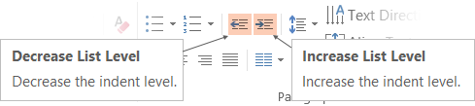
Adjusting list levels
Main topic: Segoe UI, size 28pt
Segoe UI, size 20pt for second level
Segoe UI, size 16pt for third level
Use the “Decrease List Level” and “Increase List Level” tools on the Home menu to change text levels.
Try this:
Place your cursor in the line of text that says “Segoe UI, size 20pt for second level”
Next click the Home tab, and then on the “Decrease List level” tool. Notice how the line moves up one level.
Now try placing your cursor in one of the top “Main topic…” line of text. Click the “Increase List Level” tool and see how the text is pushed in one level.
Use these 2 tools to adjust your text levels as you work

Slide 66
Bullet points layout with subtitle Set the subtitle to 20pt in the same text block, with character spacing Normal
Move the text block down vertically to align to lower guide
If you don’t see guidelines, click on the View menu, and then check the box in front of “Guides”
Hyperlink style: www.microsoft.com

Slide 67
Title square photo layout
Smaller text

Slide 68
Square photo layout

Slide 69
Slide palette info
The PowerPoint palette for this template has been built for you and is shown below.
Avoid using too many colors in your presentation.
PowerPoint Theme Accent colors
Accent 1
Accent 2
Accent 3
Accent 4
Accent 5
Accent 6
Use Accent 1 as the main accent color.
Use Accent 2 and Accent 3 only when additional colors are needed.
Use Accents 4-6 sparingly

Slide 70
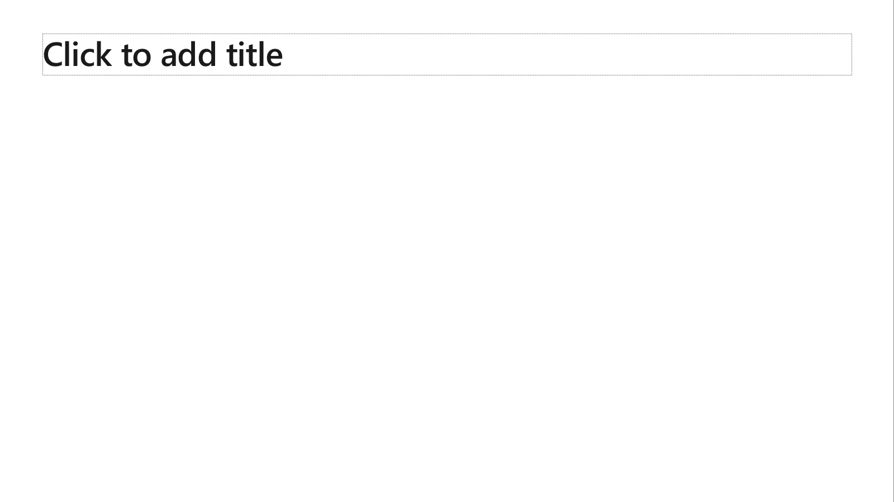
Ensure slide content is accessible
Take the following steps to create accessible content that everyone can consume effectively.
Contrast
Use high contrast colors for maximum readability
The recommended contrast ratio is at least 4.5:1
Shape and color
Use different shapes with a legend to indicate statuses to accommodate for color blindness
Example:
Alt text
Alt text helps people with screen readers understand the content of slides
You should create alternative text for shapes, pictures, charts, tables, SmartArt graphics, or other objects
Here’s how:
Right click on item
Select Edit Alt Text
Enter a Description
If an object is meant to add visual styling and doesn’t contain meaning (e.g. stylistic borders), do not add alt text and instead check Mark as decorative
Slide layouts
Using a built-in slide layout that matches your content ensures a hierarchical reading order of text blocks
Example:
If a new slide will have a title, rather than starting with a blank layout and adding a text block for the title, choose one of the built-in layouts with a title placeholder
Reading order
Screen readers describe content on the screen in the order it was created
To ensure your content is read back in the order you prefer, arrange your objects in the Selection Pane appropriately. Objects on the bottom of the selection pane are read first
Here’s how:
Click the Home tab
In the Drawing group, select the Arrange drop-down menu
Click Selection Pane…
Text
Text
Text
Subject 1
Subject 2
Subject 3
Color Contrast Analyzer
Download this tool to determine the legibility of text and the contrast of visual elements
Download
C1
C2
C3
Additional tips
Be sure to run the Accessibility Checker! Go to File click the Check for Issues drop down menu click Check Accessibility
Videos need to be accessible: If your presentation includes a video, ensure it is captioned and audio described (if appropriate)
Visit the Office Accessibility Center to learn more about accessibility in PowerPoint

Slide 71
Brand and accent colors accessibility
Type and background combinations must meet a minimum 4.5:1 contrast ratio to help ensure people of all abilities can access and understand our communications.
Pick colors carefully and avoid relying on color alone to convey information. Always provide text or other graphical cues to guide customers to our message.
Examples demonstrate correct color use for on-screen applications.
Get the Color Contrast Analyzer
Get more information on accessibility
Get the Microsoft color guidelines PDF
Dark Orange
Rich Black
R255 G147 B73 Hex #FF9349
Dark Yellow
Rich Black
R254 G240 B0 Hex #FEF000
Dark Green
Rich Black
R155 G240 B11 Hex #9BF00B
Dark Teal
Rich Black
R48 G229 B208 Hex #30E5D0
Dark Blue
Rich Black
R80 G230 B255 Hex #50E6FF
Dark Purple
Rich Black
R213 G157 B255 Hex #D59DFF
White
Rich Black
R216 G59 B1
Hex #D83B01
Rich Black
R255 G185 B0
Hex #FFB900
White
R16 G124 B16
Hex #107C10
White
Rich Black
R0 G133 B117
Hex #008575
White
Rich Black
R0 G120 B212
Hex #0078D4
White
Rich Black
R134 G97 B197
Hex #8661C5
Light Orange
White
R107 G41 B41 Hex #6B2929
Light Yellow
White
R106 G75 B22 Hex #6A4B16
Light Green White
R5 G75 B22 Hex #054B16
Light Teal
White
R39 G75 B71 Hex #274B47
Light Blue
White
R36 G58 B94 Hex #243A5E
Light Purple
White
R59 G46 B88 Hex #3B2E58
White
R255 G255 B255
Hex #FFFFFF
Orange
Dark Orange
Dark Yellow
Green
Dark Green
Teal
Dark Teal
Blue
Dark Blue
Purple
Dark Purple
Rich Black
R0 G0 B0
Hex #000000
White
Light Orange
Orange
White
Light Yellow
Yellow
White
Light Green
White
Light Teal
Teal
White
Light Blue
Blue
White
Light Purple
Purple
Extra Light Gray
R242 G242 B242
Hex #F2F2F2
Light Gray
R230 G230 B230
Hex #E6E6E6
Gray
R210 G210 B210
Hex #D2D2D2
Mid Gray
R115 G115 B115
Hex #737373
Dark Gray
R80 G80 B80
Hex #505050
Extra Dark Gray
R47 G47 B47
Hex #2F2F2F

Slide 72





PowerPoint Design Ideas
Get suggestions for slides
PowerPoint Designer can create suggestions for your slide content.
To access Design Ideas, click the “Design” tab in the Ribbon and then “Design Ideas” on the right.
Designer will also trigger when you insert an image.

Slide 73
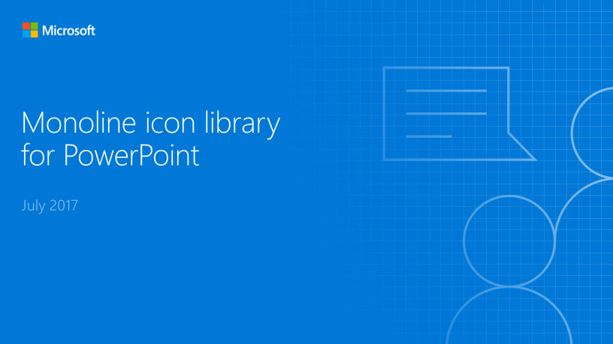
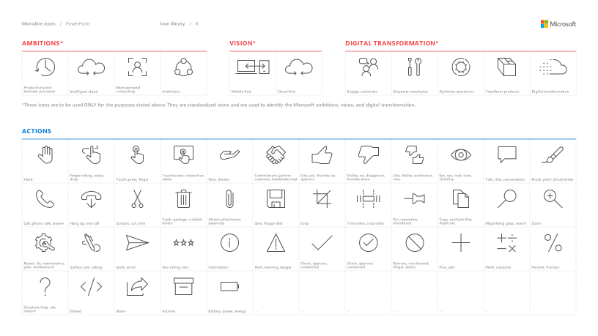
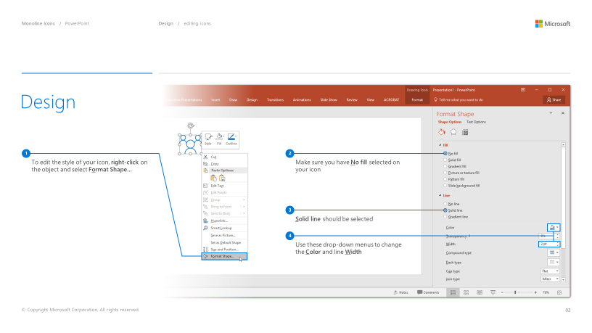
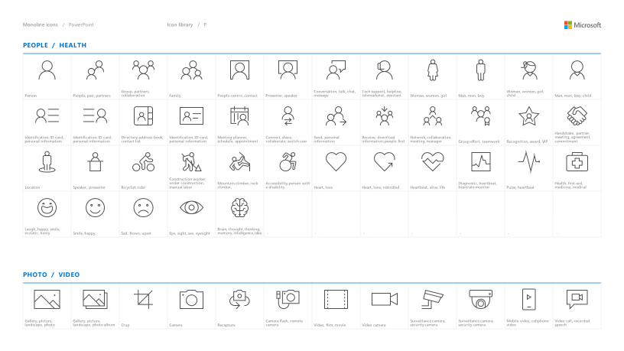
Microsoft monoline icons
Looking for icon resources?
The Monoline icon library for PowerPoint is a slide deck that provides a library of icons for use in PowerPoint presentations.
The Monoline icon style guide for PowerPoint is a pdf with additional guidelines.
Download both from Brand Central.

